Slide 1
Growing in Holiness
in Light of the Promised Blessed Hope of the Lord and Savior’s Soon Return
Notes:
The theme of Second Peter is…

Slide 2
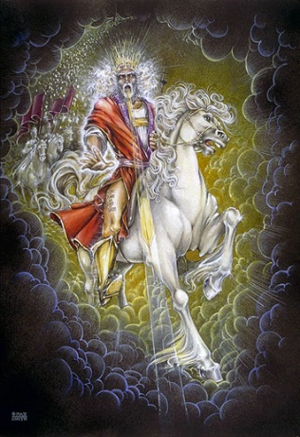
Growing in Holiness
2 PETER
The Blessed Hope is the certainty that our God and Savior Jesus Christ is retuning soon, just as He promised to rescue us before the Day of the Lord, and at the very end, the world is going to burn. In light of this Peter tells us how we should then live.
Notes:
The Blessed Hope is the certainty that our God and Savior Jesus Christ is retuning soon. At the end of all things the present created world and heaven is going to dissolve away in a great ball of fire and with a mighty roar. This is no cunningly devised fairy tale, no obscure passage of Scripture whose detains we can ignore. In fact, His coming with power and glory is based on eyewitness testimony of what he and his fellow Apostle both saw and heard. And it is confirmed by God the Father and through prophecy inspired by the Holy Spirit of God.

Slide 3
Growing in Holiness
2 PETER
Key Verse:
“Therefore, since all these things will be dissolved, what manner of persons ought you to be in holy conduct and godliness” (2 Peter 3:11)
Notes:
“Therefore, since—it is certain fact that--all these things (the heaven, the earth and the all works that are in it) will be dissolved (loosen), what kind or sort of persons ought you to be, but a person of holy conduct and godliness” (2 Peter 3:11)

Slide 4
Growing in Holiness
2 PETER
A Verse of Hope:
“Nevertheless we, according to His promise, look for new heavens and a new earth in which righteousness dwell” (2 Peter 3:13)
Notes:
At the end of all things God is going to create a new beginning. A time in which only righteous will dwell. A space in which only righteousness will exist. And an earth in which only righteous will endure.
There is no need to fear what the future holds. God is coming down to us and make all things new. Peter has already seen the future. He has already seen the Coming of the Lord. Peter does not preach a pessimistic message of doom and gloom, but teaches a lesson of light appearing out of darkness, from doom to bloom.

Slide 5
Growing in Holiness
2 PETER
The Promised Return
Notes:
In order for us to maintain a holy life in a corrupt world like ours, we must be deeply rooted in the prophetic promises of God’s word. We must hold fast/stand in the “blessed hope” of the return of our Lord and Savior Jesus Christ. Failing to do so only leads to fear and to an absence of readiness. The absence of readiness then leads to a loss of future rewards, praise, honor, and glory.

Slide 6
Growing in Holiness
2 PETER
The Prologue of the Letter – 1:3-11
The Basis and Basic of Holiness
The Purpose of the Letter - 1:12-15
To Establish Them in the Present Truth
The Body of the Letter – 1:16 – 3:13
Hold Fast to the Hope of Christ’s Coming
Notes:
In the prologue Peter establishes the basis and basics of Holiness.
After the introduction, (3-11), the Peter discloses his purpose in writing this second letter. His purpose is that his readers stand firm and to establish them in the present truth. That truth includes the certainty of Christ return--the promise of His Coming.
In the body of the letter Peter must defend this truth from opposition.
This promise, is, has and will, come under attack from “scoffers” (3:3-4) who deny Christ physical return. The remainder of the epistle is basically a defense of the godly lifestyle to which the great promise concerning the end of all things motivates us (3:11-13). The “scoffers” in turn are condemned for their unbelief and skepticism. The “scoffers” are also condemned for their immoral lifestyle, which is a direct result of their denial of Christ’s Coming in judgment.

Slide 7
Growing in Holiness
2 PETER
The Body of the Letter – 1:16 – 3:13
The Hope of Christ’s Coming…
is a Certainty – 1:16-21
will Encounter Opposition – 2:1 - 3:9
will Culminate in the Day of the Lord – 3:10-13
Notes:
The hope of Christ’s Coming is first of all a certainty. Secondly, we need to hold fast in spite of opposition and lastly because the Day is coming, the Day of the Lord that is, which could be any day now.

Slide 8
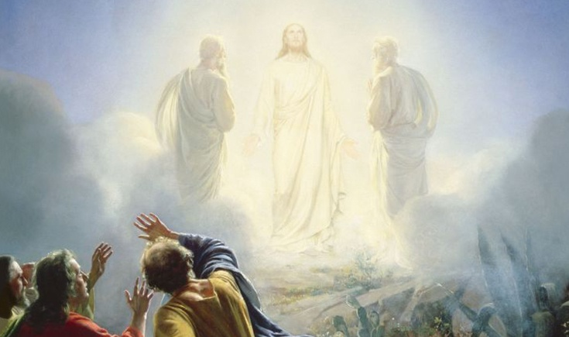
Growing in Holiness
2 PETER
The Body of the Letter – 1:16 – 3:13
The Hope of Christ’s Coming…
is a Certainty [Based on] – 1:16-21
Reliable Eyewitness Testimony – 1:16-18
Notes:
The opposition are outsides who sneaked into the church and became insiders saying that the stories of the Coming of the Lord Jesus Christ in power and glory is a mere “cunningly devised fables”. The doctrine of the Second Coming was merely a shrewdly designed “myth”. Fables and myths are fairy tales, make believe stuff.

Slide 9
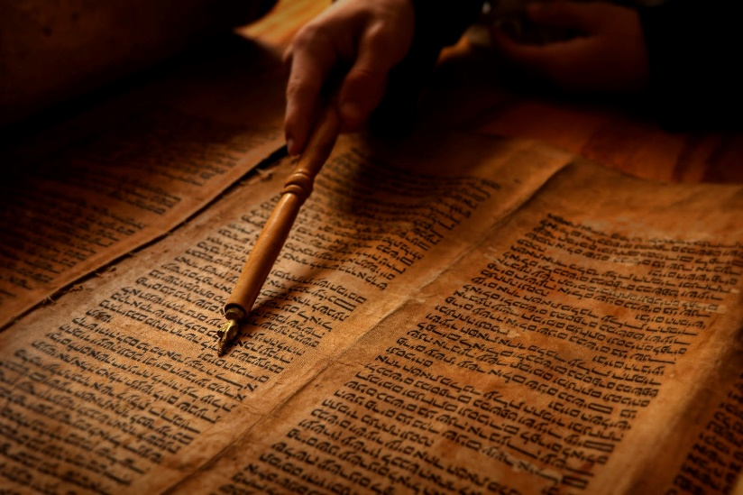
Growing in Holiness
2 PETER
The Body of the Letter – 1:16 – 3:13
The Hope of Christ’s Coming…
is a Certainty [Based on] – 1:16-21
The Prophetic Word – 1:19-21
Notes:
Secondly, Christ’s Coming is certain because God spoke about His Coming, or a certain aspect of His Coming through holy men of God who were inspired by the Holy Spirit. They only spoke about what God told them to say. They did not concoct stories about His Coming from their own minds.

Slide 10
Growing in Holiness
2 PETER
The Hope of Christ’s Coming will Encounter Opposition – 2:1 – 3:9
The Coming of False Teachers – 2:1-3
The Doom of False Teachers – 2:4-9
The Character of False Teachers – 2:10-17
The Victims of False Teachers – 2:18-22
The Doctrine of False Teachers – 3:1-9

Slide 11
2 Peter 2:1-3
Notes:
“But there were also false prophets among the people, even as there will be false teachers among you, who will secretly bring in destructive heresies, even denying the Lord who bought them, and bring on themselves swift destruction. And many will follow their destructive ways, because of whom the way of truth will be blasphemed. By covetousness they will exploit you with deceptive words; for a long time their judgment has not been idle, and their destruction does not slumber.” (2 Peter 2:1-3)

Slide 12
Growing in Holiness
2 PETER
The Hope of Christ’s Coming will Encounter Opposition – 2:1 – 3:9
The Coming of False Teachers – 2:1-3
The False Teachers Objectives – 2:1
The False Teachers Intended Results – 2:2-3a
The False Teachers Impending Judgment – 2:3b

Slide 13
Growing in Holiness
2 PETER
The Coming of False Teachers - Objectives
“But there were also false prophets among the people, even as there will be false teachers among you, who will secretly bring in destructive heresies, even denying the Lord who bought them, and bring on themselves swift destruction.” (2:1)

Slide 14
Growing in Holiness
2 PETER
The Coming of False Teachers - Objectives
“false prophets among the people”, (2:1)
Command you to Disobey (Deut. 13:1-5)
If the Prophecy does not Come to Pass (Deut. 18:21-22)
Notes:
The actual term “false prophet” is not used in the OT. There were simply prophets who spoke for God only and those who did not, but spoken words fabricated in their own minds.
God gave the people two litmus tests for determine a true or false prophet.
1) If a prophet gives you a command to disobey the Law, especially the first Law.
"If there arises among you a prophet or a dreamer of dreams, and he gives you a sign or a wonder, and the sign or the wonder comes to pass, of which he spoke to you, saying, 'Let us go after other gods' — which you have not known — 'and let us serve them,' you shall not listen to the words of that prophet or that dreamer of dreams, for the Lord your God is testing you to know whether you love the Lord your God with all your heart and with all your soul… But that prophet or that dreamer of dreams shall be put to death, because he has spoken in order to turn you away from the Lord your God…”
The prophet Balaam was such a prophet. A Prophet for hire. Though not directly from the people he prophesied rightly and spoke a blessing from the LORD, but lead the people into adultery and idolatry. “They have forsaken the right way and gone astray, following the way of Balaam… who loved the wages of unrighteousness…” (2 Peter 2:15-16)
In 1 Kings 13:11f there was an old prophet who mislead another prophet to disobey the LORD.
Their were the four hundred and fifty prophets of Baal, and the four hundred prophets of Asherah, who eat at Jezebel's table” that lead the people in worship of the Baal, that the true prophet Elijah encountered.
2) If a prophet incorrectly predicts the future,
“And if you say in your heart, 'How shall we know the word which the Lord has not spoken?' — when a prophet speaks in the name of the Lord, if the thing does not happen or come to pass, that is the thing which the Lord has not spoken; the prophet has spoken it presumptuously; you shall not be afraid of him.” (Deut. 18:21-22)
In Jeremiah 28, we have the story of the prophet Hananiah who spoke lies
concerning the captivity of the people of Israel in Babylon. He made a prediction that the Lord would break the yoke of the king of Babylon. But the Lord spoke to Jeremiah and said that the broken wooden yoke would be replace with a yoke of Iron.
“Then the prophet Jeremiah said to Hananiah the prophet, "Hear now, Hananiah, the Lord has not sent you, but you make this people trust in a lie. Therefore thus says the Lord: 'Behold, I will cast you from the face of the earth. This year you shall die, because you have taught rebellion against the Lord.'" So Hananiah the prophet died the same year in the seventh month.” (Jer. 28:15-17)

Slide 15
Growing in Holiness
2 PETER
The Coming of False Teachers - Objectives
“false prophets among the people”, (2:1)
They came from the people of Israel.
They Prophesied out of their own minds.
They Caused the People to Err and Prophesied a Message of False Peace.
Notes:
1) The false prophets rose out of Israel, not from the surrounding people.
2) They prophesied words spoken out of their own hearts or mind, not words coming from the LORD.
Ezekiel, spoke of false prophets who said of them “prophesied out of their own heart”. He says, the foolish prophets, follow their own spirit and have seen nothing!” (Ezek.13:2-3)
Though the false prophets claimed they spoke from God, Jeremiah says they lied about the Lord and His word is not in them, they are mere wind (Jer. 5:12-13) The Lord said to Jeremiah, "The prophets prophesy lies in My name. I have not sent them, commanded them, nor spoken to them; they prophesy to you a false vision, divination, a worthless thing, and the deceit of their heart. (Jer. 14:14)
The false prophets were corrupt “given to covetousness” (6:13) liars and deceivers, and reckless (23:32), who stole words from the Lord (23:30).
3) The false prophets caused the people to err,
"And I have seen folly in the prophets of Samaria: They prophesied by Baal and caused My people Israel to err… They continually say to those who despise Me, 'The Lord has said, "You shall have peace"'; And to everyone who walks according to the dictates of his own heart, they say, 'No evil shall come upon you.'" (Jer. 23:13, 17)
"Therefore behold, I am against the prophets," says the Lord, "who steal My words everyone from his neighbor. Behold, I am against the prophets," says the Lord, "who use their tongues and say, 'He says.' Behold, I am against those who prophesy false dreams," says the Lord, "and tell them, and cause My people to err by their lies and by their recklessness. Yet I did not send them or command them; therefore they shall not profit this people at all," says the Lord.” (Jer. 23:30-32)
“…because they have seduced My people, saying, 'Peace!' when there is no peace —…and who see visions of peace for her when there is no peace,'" says the Lord God. (Ezek. 13:10-11; 13:15-16)
“This is what the Lord says: ‘As for the prophets who lead my people astray, if one feeds them, they proclaim 'peace‘…” (Micah 3:5) [NIV]

Slide 16
Growing in Holiness
2 PETER
The Coming of False Teachers - Objectives
“But there were also false prophets among the people, even as there will be false teachers among you, who will secretly bring in destructive heresies, even denying the Lord who bought them, and bring on themselves swift destruction.” (2:1)
Notes:
Peter says that just as there were false prophets among the people, in the same way Christians can expect false teachers to rise up among the churches. Their teaching and MO—Mode of Operation is the same--destructive heresies—nothing but lies.

Slide 17
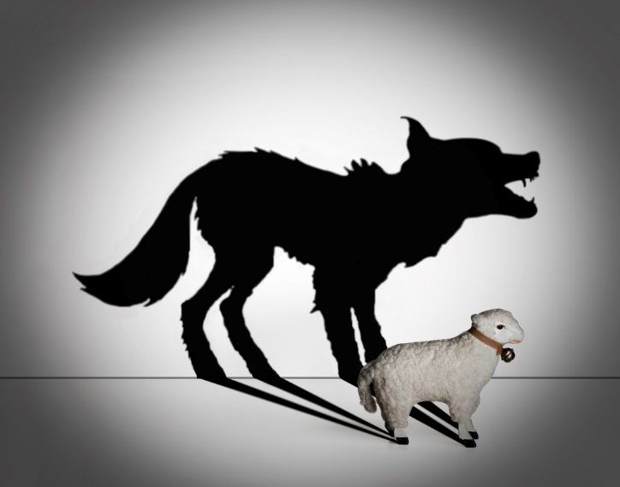
Growing in Holiness
2 PETER
Pseudo Prophets
Pseudo Teachers
Claim to Speak for God
Claim to Speak the Truth
Speak Out of their Own Mind
Make up Stories they Invented in their Mind
Speak Deceitful Lies
Speak Deceitful Words
Proclaim Peace
Proclaim Peace and Safety
Notes:
The Devil’s counterfeits with their crafty activates are always present. They both use the same MO--Mode of Operation. Why? Because it works so, deceiving their victims. From their perspective, “If it ain’t broke don’t fix it”. They follow their leader the great deceiver, the Devil, the father of lies. But Jesus said, “Take heed that you not be deceived. For many will come in My name” (Luke 21:8)

Slide 18
Growing in Holiness
2 PETER
The Coming of False Teachers - Objectives
“But there were also false prophets among the people, even as there will be false teachers among you, who will secretly bring in destructive heresies, even denying the Lord who bought them, and bring on themselves swift destruction.” (2:1)
Notes:
It is important to note that Peter designates these people as “false teacher”, not “false prophets”. They do not pretend to prophesy, but rather they deny prophecy. These pseudo teachers do not make charismatic or fascinating claims, as many others do today, but they make anti-charismatic denials of the prophesies of Scripture.

Slide 19
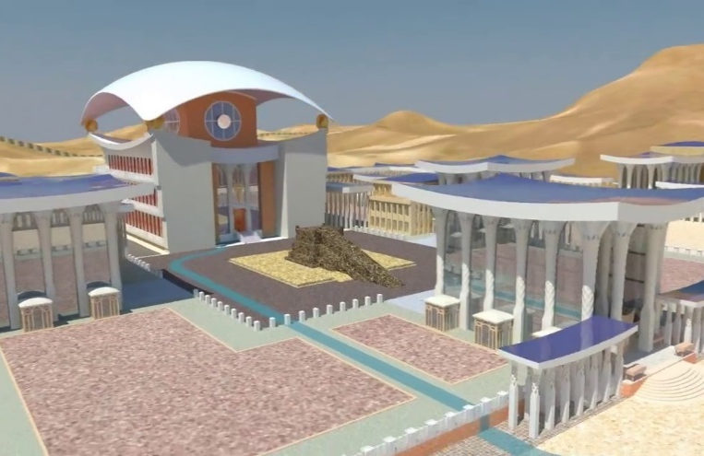
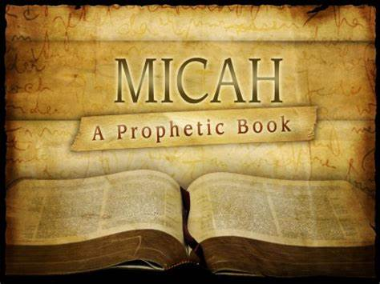
Growing in Holiness
2 PETER
Daniel
Ezekiel
Hold Fast to the Hope of Christ’s Coming
Notes:
The first characteristic of these false teachers is their denial of the Second Coming. They have accused Peter and the other apostles of wrongly pasting together the numerous prophecies into a single coherent picture of the future return of Christ. To them the truth about the Second coming is a hodgepodge of “cunningly devised fables” (1:16).
But Peter insists that the Second Coming was doubly confirmed by the Transfiguration event which he and the two other disciples were eyewitness too. Peter also insists the it is wrong to treat OT prophecies as if they each had their own isolated interpretations or their own particular explanation, being understood as isolated utterances of men speaking to their own particular historical life situation, that in many cases had already been fulfilled in the past or are presently being fulfilled in some allegorical or spiritual sense.
Many skeptics and anti-supernaturalist today insist that these prophets could not have prophesied the distant future, simply because that would require them to know the future, which is impossible. So they rationally conclude that they were writing about events that had already taken place. For example, Nahum predicted the fall of Nineveh with great detail. Knowing these great details in advance is impossible, therefore he wrote a description of what happened and then whoever the author was pretend to predict the future—this is there common MO.
However, by interpreting the OT Scriptures in this manner they deny the single authorship of these prophesies by the Holy Spirit Himself. “Instead, the unity of their teaching about the prophetic future is a result of their own interpretation by the Holy Spirit.” (Hodge, p. 53)
Many modern interpretation of the Second Arrival say the placing together of OT prophecies with NT prophecies concerning the blessed hope has led to cleverly concocted myths, a web of speculation, about the return of Christ to earth to reign. But modern Biblical scholarship is simply a fulfilment of a surge of false teachers and teaching who were going to appear in “the last days”.

Slide 20
Growing in Holiness
2 PETER
The Coming of False Teachers - Objectives
“But there were also false prophets among the people, even as there will be false teachers among you, who will secretly bring in destructive heresies, even denying the Lord who bought them, and bring on themselves swift destruction.” (2:1)
Notes:
These false teachers are said to bring their destructive heresies in secretly which implies they enter the churches under false colors by concealing the doctrines they actually hold until they are safely part of the congregation. “secretly” conveys a notion of stealth or maliciousness. If they introduced their doctrines up front churches might naturally reject them. Like the false brethren in Gal. 2:4 these pseudo teachers do not reveal their true leanings until they join the churches.
It’s obvious that they have made some outward profession of faith in Christ. They know that they are only pretending to believe. God knows the heart. People in the churches cannot be certain or discern a true believer and one who is merely professing to believe. Ultimately, we will know them by their fruits, as Jesus said (Matt. 7:16) And it will be their words and not their works that will reveal their true nature. We cannot determine their true nature by their works alone, even the wicked can do good things. Religious folks can appear to morally upright, but on the inside they are bad to the bone.
In many cases it’s not what they confess, but what they fail to confess. The Apostle John would later encounter the same or other false teachers 20 years later, when he said, “For many deceivers have gone out into the world who do not confess Jesus Christ as coming in the flesh. This is a deceiver and an antichrist.” (2 John 7)
It clear from statements Peter makes in 2:9 and 2:17 that he regards these false teachers as unsaved. They resemble the “false brethren” referred to by Paul in Gal. 2:4 who, “secretly brought in (who came in by stealth to spy out our liberty which we have in Christ Jesus, that they might bring us into bondage)”.
Now Peter has discerned their true nature and describes these men as bringing in from the outside destructive heresies. In a technical sense a “heresy” is a simply “sect”, could refer to a religious party, groups with different opinions. The Pharisees was a sect amongst the Jewish people, even Christians were considered a “sect”. It could refer to any group of people with a chosen course of thought or actions, who may create a article of faith (such as a doctrinally statement) or a way of life. In a technical sense, we are all heretics here!
However, the psuedo teachers are those who bring in alongside destructive or ruinous doctrines (literally doctrines of destruction). That is, their destructive doctrines are ruinous in their spiritual effects.

Slide 21
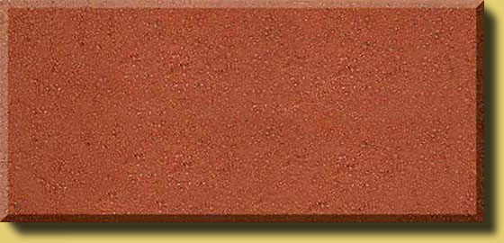
Destructive Heresy
HATE
CRUELTY
UNGODLINESS
FORSAKING
UNCONTROLLED
IGNORANCE
UNRIGHTEOUSNESS
UNBELIEF
Notes:
The result of their destructive heresy is unprofitable to spiritual growth, and create the opposite effect of growing in holiness.

Slide 22
Destructive Heresy
Constructive Heresy
HATE
LOVE
CRUELTY
BRO. KINDNESS
UNGODLINESS
GODLINESS
FORSAKING
PERSEVERANCE
UNCONTROLLED
SELF CONTROL
IGNORANCE
KNOWLEDGE
UNRIGHTEOUSNESS
VIRTUE
UNBELIEF
FAITH
Notes:
Adhering to Christian heresy/doctrine will produce Constructive effects and profitable results for those who add these holy qualities to their lives.

Slide 23
Growing in Holiness
2 PETER
The Coming of False Teachers - Objectives
“But there were also false prophets among the people, even as there will be false teachers among you, who will secretly bring in destructive heresies, even denying the Lord who bought them, and bring on themselves swift destruction.” (2:1)
Notes:
Though Peter regards these false teachers as unsaved, as 2:20-22 shows real Christians, believers in Christ, can and will be deluded by them, but it does not follow that they then lose their eternal salvation. The NT clearly teach once saved, always saved! Faith alone in Christ alone for eternal life that can never be lost. The destructive effects of the false doctrine will not go as far as to deprive any Christian of eternal life. No believer in Christ will ever hear, “I never knew you”. Only professors of Christ who rely on their works to get them will here such words.
On the other hand, tremendous damage can be done to followers of destructive doctrines, including believers in Christ. Real harm can be done to the spiritual life with negative effects on their present experience as well as upon the prospects of future rewards and honor before the Father. Followers of the way of truth in Christ, who no longer abide in the apostles doctrines and begins to listen to and follow the destructive doctrines and ways of the false teachers will bring what could have been a victorious present condition to a catastrophic spiritual setback, they would become what is known as a backslider.

Slide 24
Growing in Holiness
2 PETER
The Coming of False Teachers - Objectives
“But there were also false prophets among the people, even as there will be false teachers among you, who will secretly bring in destructive heresies, even denying the Lord who bought them, and bring on themselves swift destruction.” (2:1)
Notes:
The doctrines of wreckage these men bring in involve a rejection of the authority of “the Lord who bought them”. The word Lord here is not the usual one “Kurios” that we usually find, but it is the word “Despotes” which means “Master”. A word is also widely used in politic context to describe an autocrat or dictator who has absolute power. The expression sovereign Lord applies equally to God (Lk. 2:29; Acts 4:24; Rev. 6:16). Even masters who bought slaves for themselves expects obedience, so it is with Jesus as sovereign Lord has bought humanity out of sin and demands obedience.
We see here they deny the person of Christ and the provision He has provided, in which the Apostles proclaimed.
Peter has in mind that even Jesus died and paid for the ransom price to purchase/redeem even these false teachers who are unsaved. This affirms the universality of the atonement of Christ, an unlimited atonement. The Scriptures know no such thing as a limited atonement for some or only for the elect. Not only do they not believe in Jesus for eternal life, but also deny that his death was sufficient to provide it. “Thus the sin of the false teachers in denying the Lord becomes more heinous precisely because the Lord is the One who bought them at the cost of His own life’s blood.” (Hodge, p. 56)
One view of the atonement is that Jesus potentially died and redeemed the world. The “redeemed” is used in the sense that Christ paid the redemption price for the salvation for all of humanity, but it is only applies to those who believe. Christ’s death is sufficient for all, but it is only “efficient” or “effectual” only for those who believe in the person of Christ and His provision. (BKC, p. 870)
Another view of the atonement is that Jesus “actually” paid for all sin, even the sin of unbelief. Jesus paid the legal purchase price to redeem the whole world. Therefore, it can be said that legally the entire world is redeemed, even if though don’t know it or believe it. But, the entire world is not saved. There is no universal salvation for all. Why? Because the entire world still needs eternal life. And the only way to receive eternal life is to believe in Christ person, provision and proclamation.
Did you know that not all unsaved people deny the Lord Jesus Christ? Many actually confess it, while actually failing to do the one thing the Father wills them to do, keep the commandment to believe in His Son for eternal life. Instead they rely on their religious works to save them, but they will be rejected. They fail to enter by “the narrow gate” of simple faith in God’s Son.
But these false teachers not only fail to believe in Christ, but also reject His Lordship. He is indeed their Lord because He died for them and has an absolute right to their obedience. No one can make Him Lord, He just is the Lord of all!

Slide 25
Growing in Holiness
2 PETER
The Coming of False Teachers - Objectives
“But there were also false prophets among the people, even as there will be false teachers among you, who will secretly bring in destructive heresies, even denying the Lord who bought them, and bring on themselves swift destruction.” (2:1)
Notes:
To reject His Lordship is to incur many dangers and bring on themselves swift destruction. Their ruin will be great.

Slide 26
Growing in Holiness
2 PETER
The Coming of False Teachers – Results
“And many will follow their destructive ways, because of whom the way of truth will be blasphemed. By covetousness they will exploit you with deceptive words…” (2:2-3a)
Notes:
In verse 2 and 3a we have the false teacher’s intended result.
Peter anticipates that “many will follow their destructive ways” Their “destructive heresy” results in their “destructive ways”. Their “destructive ways” are morally devastating, leading to depraved lifestyle.
“From their base inside the church, such teachers position themselves first to win the confidence of the congregation and then to talk persuasively about their special doctrines.” (Hodge, p. 57) Their heresy is a spin off of the authentic free grace gospel.

Slide 27
Growing in Holiness
2 PETER
The Coming of False Teachers – Results
“For certain men have crept in unnoticed, who long ago were marked out for this condemnation, ungodly men, who turn the grace of our God into lewdness and deny the only Lord God and our Lord Jesus Christ.” (Jude 4)
Notes:
Some 15 years later Jude would write in the past tense that, “certain men have crept in unnoticed, who long ago were marked out for this condemnation, ungodly men, who turn the grace of our God into lewdness and deny the only Lord God and our Lord Jesus Christ.” (Jude 4)
The ungodly impostors of Jude 4 “proclaimed” a version of the grace gospel, but only for the purpose of abusing God’s grace so that they may follow after their own ungodly lusts. They proclaim a similar, but inauthentic free grace gospel—not freedom from sin, but freedom to sin.

Slide 28
Growing in Holiness
2 PETER
The Coming of False Teachers – Results
“And many will follow their destructive ways, because of whom the way of truth will be blasphemed. By covetousness they will exploit you with deceptive words…” (2:2-3a)
Notes:
Its most likely these false teachers have good communication skills, combined with a charming “charismatic” personality in which they use to attract an audience. Clearly Peter anticipates spiritual casualties.
Christian casualties are a source of real embarrassment for the testimony of the Church and for Christ whom they say they follow—”the way of truth will be blasphemed”. Believers who are duped by these men will be lured into a sensual and corrupt lifestyle. We all know to well the eagerness the world has in pointing out the hypocrisy of the church and pointing figures at Christians who have fallen into sinful ways, and say, “See, they are just like us”.
Peter’s purpose in writing this very epistle is to warn the church not to be among those who are deceived in this way.

Slide 29
Growing in Holiness
2 PETER
The Coming of False Teachers – Results
“And many will follow their destructive ways, because of whom the way of truth will be blasphemed. By covetousness they will exploit you with deceptive words…” (2:2-3a)
“In their greed these teachers will exploit you with stories they have made up.” (2:3a) [NIV]
Notes:
Verse 2 tells us of the success the false teachers will have in leading Christians astray, for “many will follow”, they will have many disciples. But how? How will they manage to be so successful? “By covetousness they will exploit you with deceptive words.” The NIV says, “In their greed these teachers will exploit you with stories they have made up.”
Their hook by which they lure their hearers is basic covetousness or greed. No matter how mature a Christians may be, he is not immune to the covetous inclinations of the sinful nature still resident in the flesh. Their many area of success is most likely among new Christians who have not yet become discerning students of the Word. This is why Peter warns them, “not be carried away by the error of lawless men and fall from your secure position. But grow in the grace and knowledge of our Lord and Savior Jesus Christ.” (2 Peter 3:17-18) [NIV]
The deceives as they are will use “deceptive words”, presenting their doctrines in a sophisticated form well calculating to disguised its immoral character in order to appeal to the covetousness hearts of those who will listen to them. Modern day teachers may use deceptive presentations to allure their audience with phrases like “self-actualization” or “breaking the bondage of legalistic restraints”, or offering “authentic living free from traditional custom and restraints”, after all you are free in Christ. These are some of the religious “con-games” that people play to adapt their deceptive words to a vulnerable modern audience.
Lastly, we must know that the false teachers activity of deception is not going unnoticed by God.

Slide 30
Growing in Holiness
2 PETER
The Coming of False Teachers – Results
“for a long time their judgment has not been idle, and their destruction does not slumber.” (2:3b)
Notes:
For Peter mentions the coming false teachers impending judgment and destruction. Such men he tells us have judgment awaiting them that is nothing less than eternal punishment. He is going to tell us that this judgment is already active, and it has been active “for a long time” it “has not been idle.”
Peter is going to remind us of three previous “wake up calls” of God’s judgment. We have in America “Remember 911”, “Remember Peril Harbor”, “Remember the Alamo—”Never Forget!” In the Bible we have remember 1) the angles who sinned and who are in chains of darkness, remember 2) the ancient world that perished in the global flood, and remember 3) the destruction of the cities of Sodom and Gomorrah. They all received temporal judgment in time, being then sent to the realm of the lost and the place of the dead “sheol” in Hebrew or “hades” in Greek in which they are currently undergoing punishment, awaiting the final pronouncement of their doom on the day of Judgment at the Great White Throne Judgement describes in Rev. 20:11-15. Verse 2:9 tells us the Lord knows how… “to reserve the unjust under punishment, for the day of judgment.”
Judgment is not asleep. Some people say, “Why doesn’t God do something with all of the evil in the world!” God is doing something and He is going to do something to bring it all to an end. God’s retributive work is currently active, in operation, and has been for a long time, without interlude—it does not slumber.
This doctrine does sit well especially with the ethics of the present world-system which lies under the control of the evil one, which is “non-judgmental” refusing to acknowledge a God who warns mankind of an everlasting punishment in not so great place. Many who profess and teach the Bible today attempt to accommodate the spirit of “non-judgmentalism”, but in the process are seriously derelict in their duty to alert men of the reality of “judgment to come” (Acts 24:25). And they are in conflict with the teachings of Jesus, Paul and Peter’s own words here in this second chapter of his second letter—a solemn reminder of the truth of everlasting punishment.

Slide 31
Growing in Holiness
2 PETER
The Coming of False Teachers - Judgment
"Where is the promise of His coming?” (3:4a)
"The Lord is not slack concerning His promise, as some count slackness,
but is longsuffering toward us, not
willing that any should perish but
that all should come to repentance.” (3:9)
Notes:
But why is the Lord taking so long to return? Peter anticipates the scoffer’s doctrine when the say, “Where is the promise of His coming?” (3:4) Peter’s answer is, “The Lord is not slack concerning His promise, as some count slackness, but is longsuffering toward us, not willing that any should perish but that all should come to repentance.” (3:9)
God gave the great city of Nineveh 40 days to turn from their wicked ways. They repented and God relented. The Lord has given all of mankind nearly 2000 years to turn from its wicked ways and so far the Lord has relented, He is delaying His return, because He is longsuffering and slow to anger. But it doesn’t say His longsuffering is forever.

Slide 32
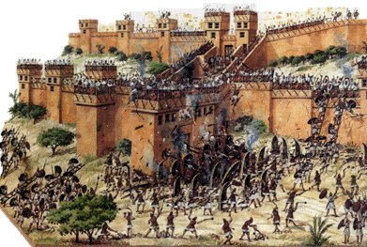
Growing in Holiness
2 PETER
The Coming of False Teachers - Judgment
The Great City of Nineveh
The City of Blood
Notes:
The Lord sent another prophet to Nineveh 100 years later after Jonah, by the name of Nahum, meaning “comfort”. It was going to a comfort to Israel that God was going to destroy her enemies. The city was now called the city of blood, for its love of violence and warfare. Nineveh had reverted to its wicked ways and was now the Lord through His prophet announces it destruction.

Slide 33
Growing in Holiness
2 PETER
The Coming of False Teachers - Judgment
"The Lord is a jealous and avenging God; the Lord takes vengeance and is filled with wrath. The Lord takes vengeance on his foes and maintains his wrath against his enemies. The Lord is slow to anger and great in power; the Lord will not leave the guilty unpunished.” (Nahum 1:2-3)
Notes:
God is jealous, and the Lord avenges; The Lord avenges and is furious. The Lord will take vengeance on His adversaries, and He reserves wrath for His enemies; The Lord is slow to anger and great in power; the Lord will not leave the guilty unpunished.” (Nahum 1:2-3) [NIV]
We live in the days of Jonah, or better yet between the days of Jonah and the days of Nahum. God is giving mankind time to repent for He truly does not desire to destroy him. But it is certain judgement is coming!

Slide 34
Growing in Holiness
2 PETER
The Coming of False Teachers - Judgment
“The Lord is good, a refuge in times of trouble. He cares for those who trust in him, but with an overwhelming flood he will make an end… he will pursue his foes...” (Nahum 1:7-8) [NIV]
Notes:
The Lord is good, a stronghold in the day of trouble; And He knows those who trust in Him. but with an overwhelming flood he will make an end… he will pursue his foes...” (Nahum 1:7-8) We see here the grace of God and His justice both satisfied.

Slide 35
Growing in Holiness
2 PETER
Conclusion
Hold Fast to the Hope of Christ’s Coming
Notes:
The teachers who advocate a self-indulgent lifestyle mark by immorality pose a serious threat to the Church. They are the Lord’s enemies. The theological premise that underlines their teaching is a rejection of the Second Coming to Christ to rescue the righteous, judge the wicked, and to establish a eternal kingdom mark by righteousness. If this doctrine is nothing more than “cunningly devise fable or myth” then Christians will not find in it “precious promises” that is going to motivate them to godly living and help them escape “the corruption that is in the world”. The loss of a real and vibrant hope in the establishment of kingdom in which only righteous well dwell will be lost and deal a serious blow to laying a strong foundation of true Christian morality.
Peter is telling us to Hold Fast the Hope of Christ’s Coming—it is a certainty based on reliable eyewitness testimony and based on reliable prophetic prophecy. Don’t fall for these pseudo teachers with their corrupt message and corrupt lifestyle.
Opposition to the message of the hope of Christ’s Coming is here and with it the danger of falling victim to their corruption. If we are to overcome the corruption of this world and the false teachers and grow in holiness we must stand firm in the hope of Christ’s coming! When we stand firm in a deep confidence in the reality of direct, inspired prophecy of God, we gain full-hearted confidence in the expectation of the Savior’s soon return.

